Slide 1
Tutorial 1: Environment setup and Python examples
COMP 4331
TA: Vincent Cheng
yzhengbs@cse.ust.hk
HKUST

Slide 2
Outline
Handout info and files
Software: Python, Anaconda, JupyterLab
Hardware: Computing resource
Python examples
Notes:
put tutorial1_info.txt, tutorial1.ipynb, tutorial1.py, tutorial1.pptx into chatbox

Slide 3
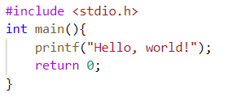
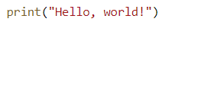

Python
Python is a simple and elegant programming language; it is like human’s languages.
Print “Hello, world!” in C and Python:
Python is used in many areas, including data science
For data science, a very good way to install and manage Python is by Anaconda!
C programming language
Python programming language

Slide 4
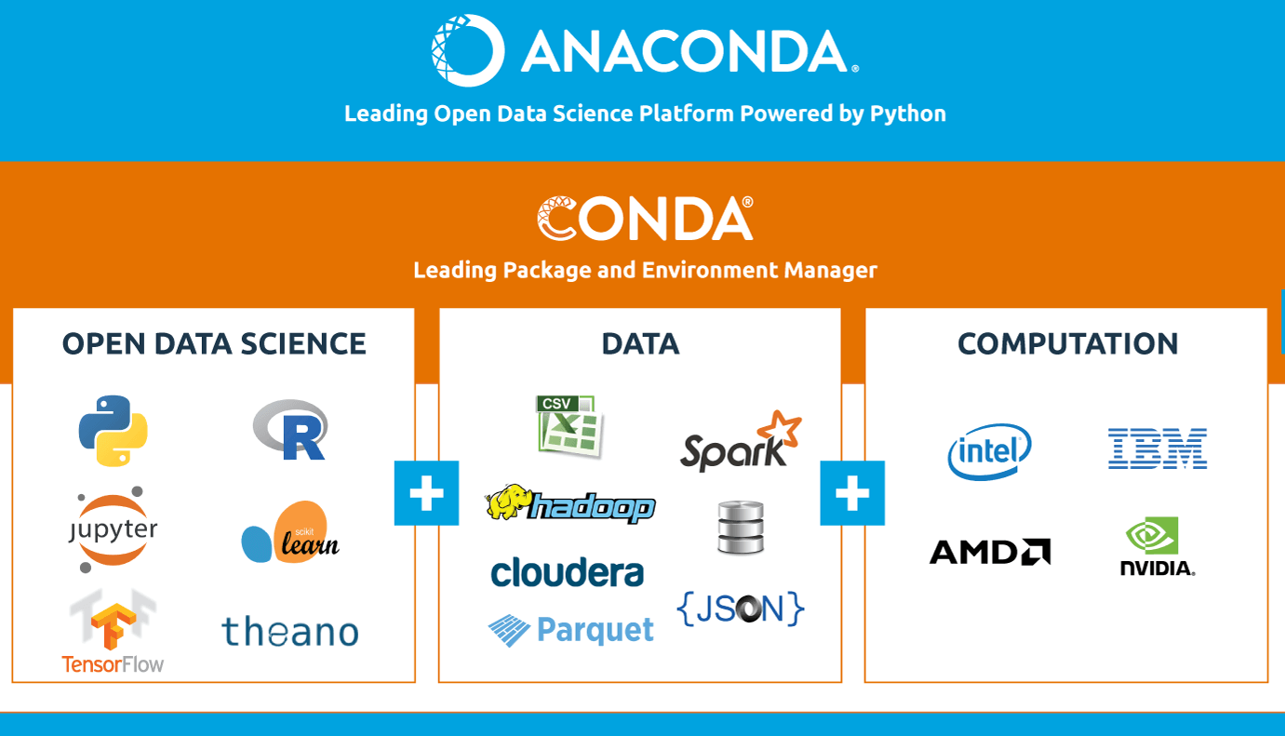
Anaconda
Anaconda is a free distribution of the Python programming languages for data science.
Anaconda = conda + many other tools (Python, JupyterLab, numpy, … )

Slide 5
Conda
Conda is an open-source, cross-platform package manager and environment management system.
What is environment?
A conda environment is a directory that contains a specific collection of conda packages that you have installed.
Why do we need environment management?
Different python packages may be conflicted! e.g. PyTorch and Tensorflow.
Sometimes, we need a specific python version!

Slide 6
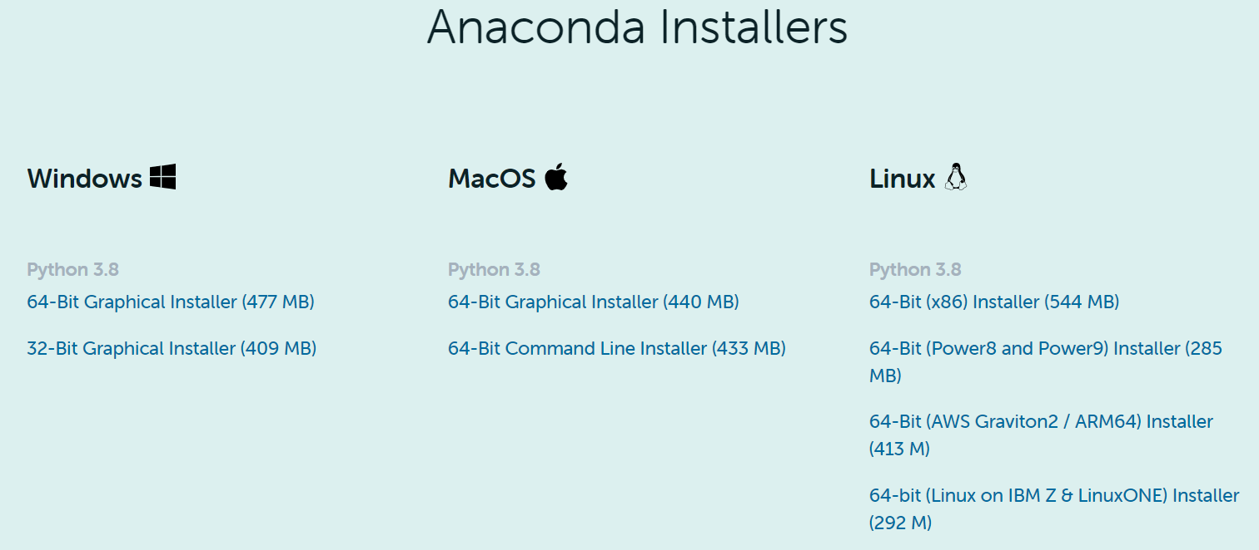
Anaconda installation
Download from https://www.anaconda.com/products/individual
Notes:
copy the link into chatbox
free
available on three major os

Slide 7
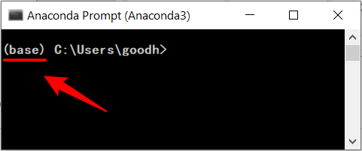
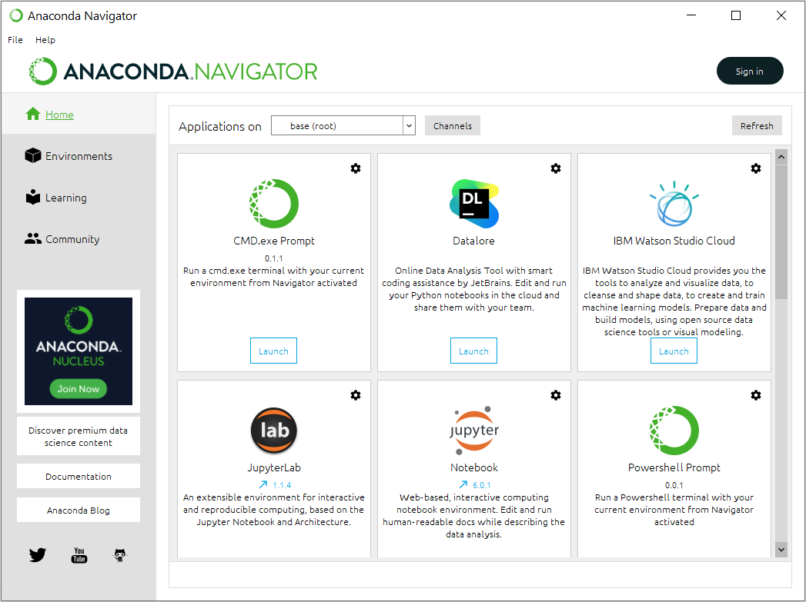
Anaconda interface
Command line interface
Graphic user interface

Slide 8
Conda commands
environment management
conda create -n env_name (Create a conda environment)
conda activate env_name (Activate the environment to use it)
conda deactivate (Deactivai hte the environment)
conda info --envs (Get a list of all my environments)
package manager:
conda list (View list of packages and versions installed in active environment)
conda install pkg_name (Install new package in the current environment, e.g. python=3.9, matplotlib, pandas, numpy, scipy)
conda update pkg_name (Update package in the current environment)
conda uninstall pkg_name (Uninstall package from the current environment)
Notes:
http://yiminz.me/doc/cheatconda.pdf
install jupyterlab during this slide

Slide 9
Useful packages to install
matplotlib
a package for creating static, animated, and interactive visualizations
numpy
a package add support for large, multi-dimensional arrays and scientific computing
pandas
a package for data manipulation and analysis
scipy
a package for scientific computing and technical computing
sklearn
a package provides machine learning tools (conda install -c conda-forge scikit-learn)
networkx
a package for creation, manipulation, and study of networks
…
Notes:
http://yiminz.me/doc/cheatconda.pdf
install jupyterlab during this slide

Slide 10
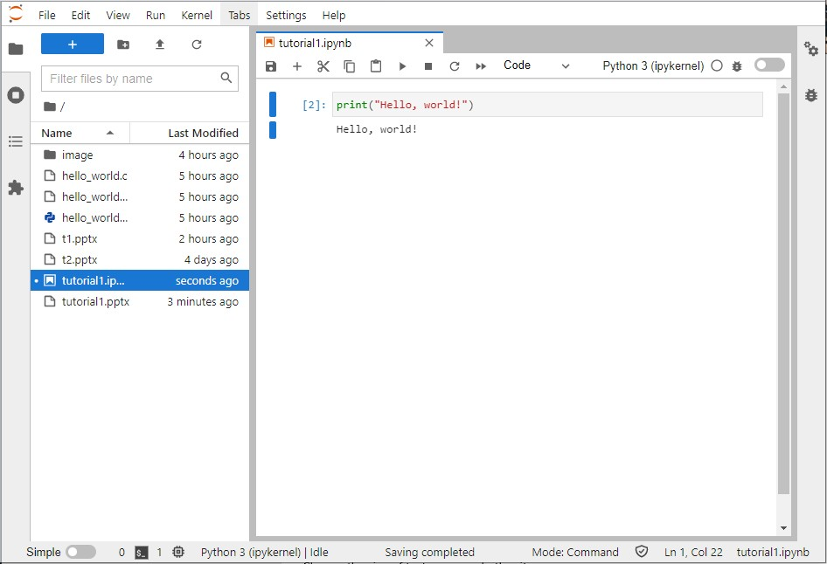
JupyterLab
JupyterLab is a web-based interactive development environment for writing Python with data science purpose.
Activate your conda environment
conda activate env_name
Install JupyterLab
conda install -c conda-forge jupyterlab
Run JupyterLab
jupyter lab (default port 8888)
jupyter lab –port=port_number (optionally with another port)
Notes:
http://yiminz.me/doc/cheatconda.pdf
install jupyterlab during this slide

Slide 11
Computing resource
Personal computer
Undergraduate Laboratories
https://cssystem.cse.ust.hk/Facilities/index.html
Remote servers available for Undergraduate
https://cssystem.cse.ust.hk/Facilities/ug_cluster/gpu.html
ugcpu.cse.ust.hk (available to all UG(CSE?))
ugcpu6.cse.ust.hk / ugcpu7.cse.ust.hk (available to COMP4331)
ssh yzhengbs@ugcpu6.cse.ust.hk / ugcpu7.cse.ust.hk (login via SSH; replace yzhengbs with your cas name)
bash && source /data1/comp4331/anaconda3/.bashrc (activate conda environment)
Google Colab
colab.research.google.com/drive/179U4fiYYCqDXyFQ4s4LIdMKSGo8cjbqO?usp=sharing
…

Slide 12
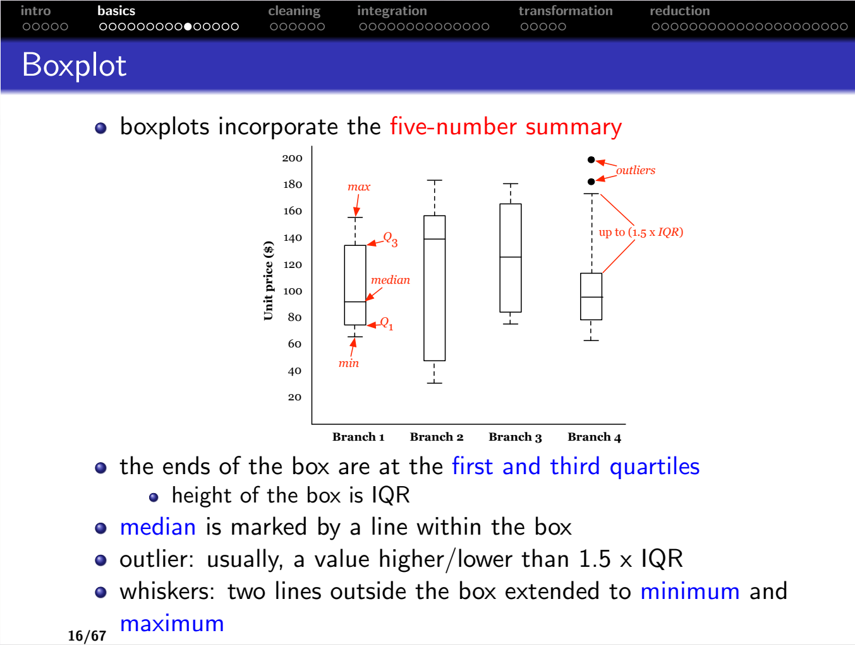
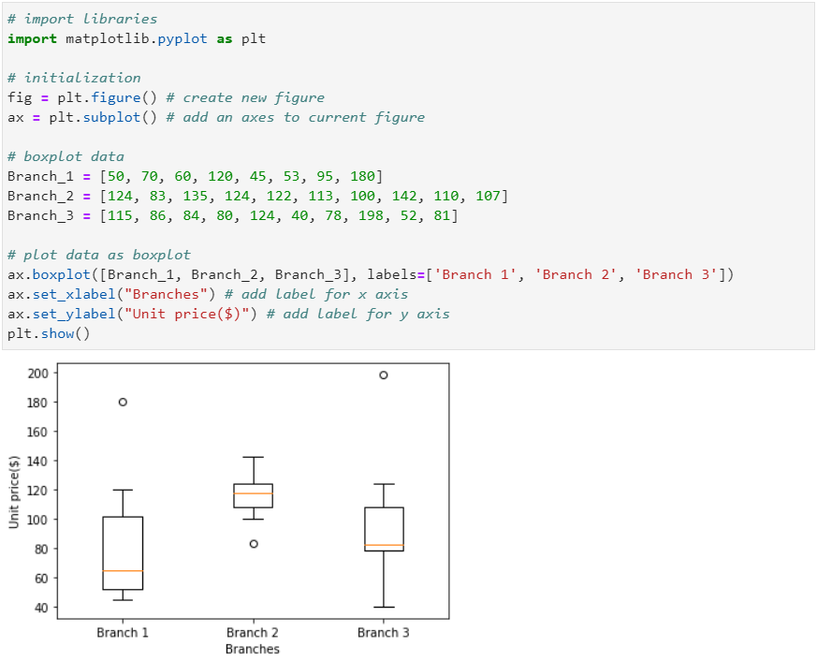
Python examples - Boxplot
Notes:
remember to install pip install matplotlib
https://matplotlib.org/stable/api/_as_gen/matplotlib.axes.Axes.boxplot.html#matplotlib.axes.Axes.boxplot
https://matplotlib.org/stable/gallery/statistics/boxplot_demo.html

Slide 13
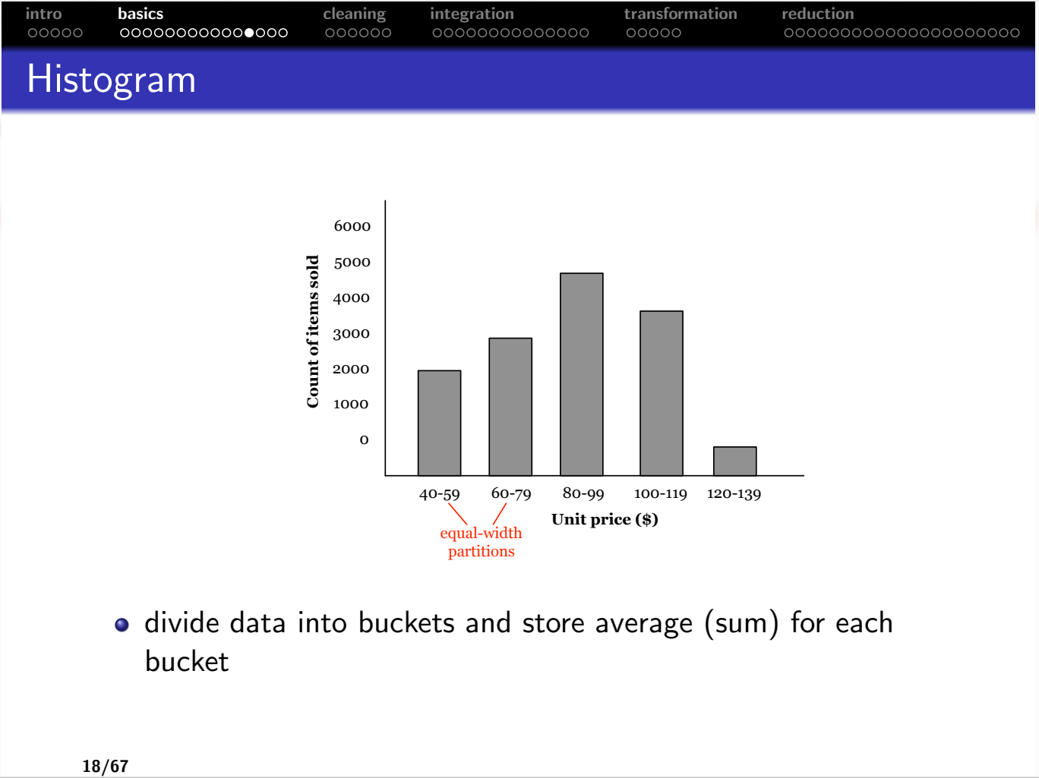
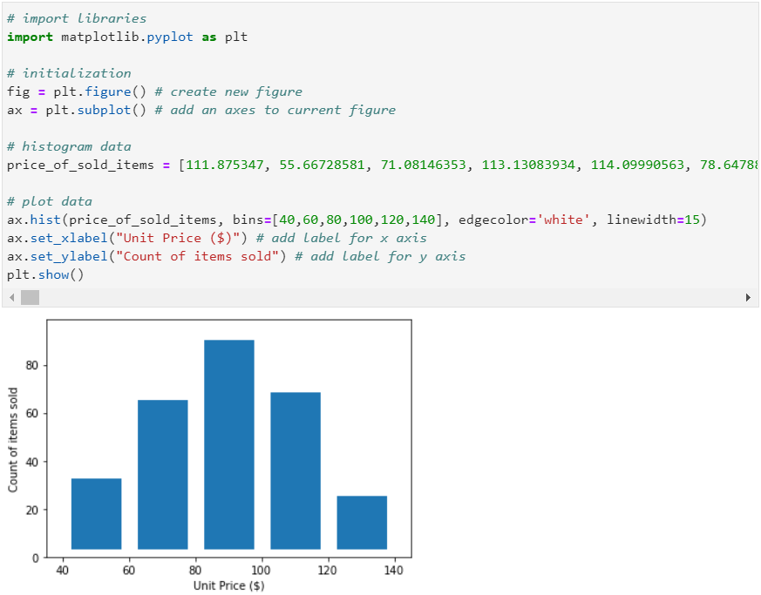
Python examples - Histogram
Notes:
https://matplotlib.org/stable/api/_as_gen/matplotlib.pyplot.hist.html
https://matplotlib.org/stable/gallery/pyplots/pyplot_text.html#sphx-glr-gallery-pyplots-pyplot-text-py

Slide 14
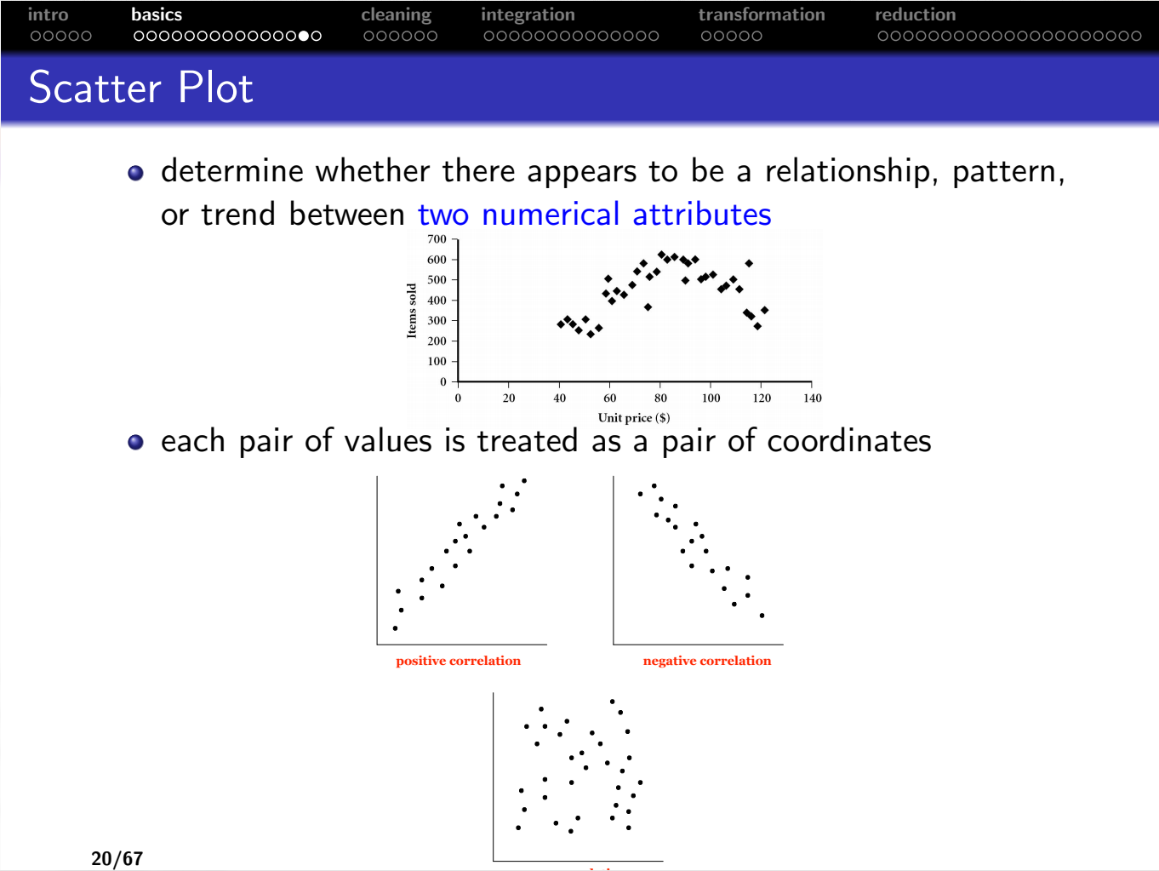
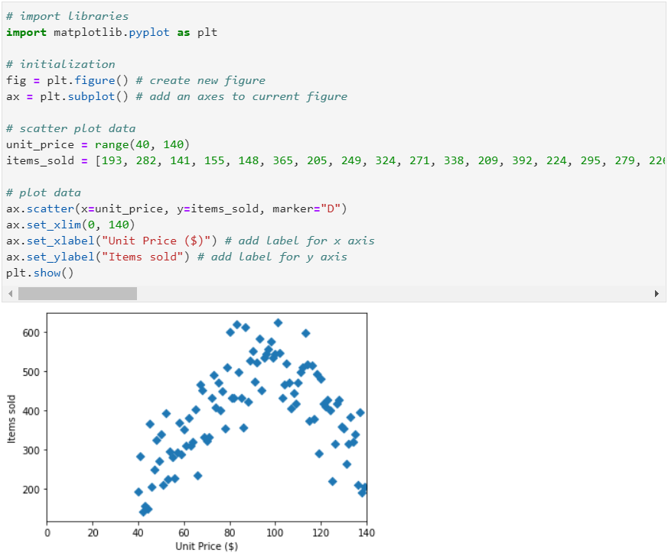
Python examples – Scatter Plot
Notes:
https://matplotlib.org/stable/api/_as_gen/matplotlib.axes.Axes.scatter.html

Slide 15
Thanks!

Slide 16
Additional material
Notes:
https://matplotlib.org/stable/api/_as_gen/matplotlib.axes.Axes.scatter.html

